Slide 1
Mobile Site Home Page Report of Findings from Usability Study AUGUST 13, 2012
Prepared by:
Madeline Jannotta – User Experience Researcher
Kerry McAleer-Forte, Manager of UX Research
Karol Czyrka, Director of User Experience Practice
Andrew Daniel, DVP Creative and User Experience

Slide 2
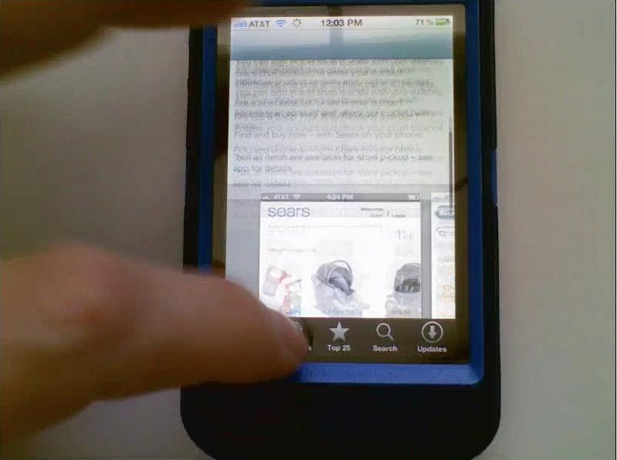
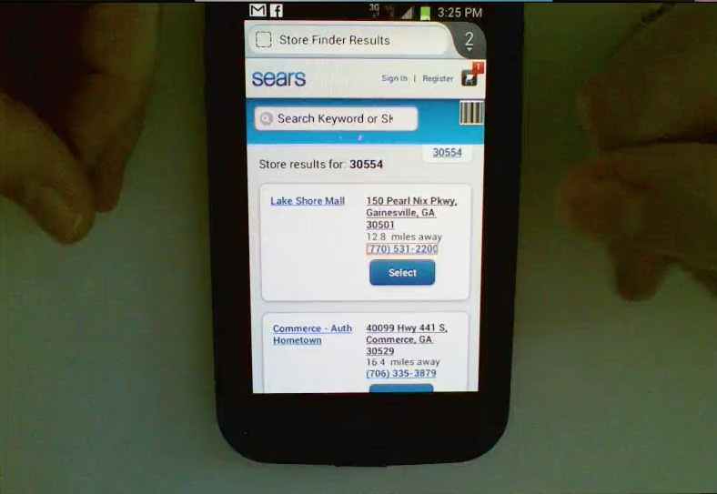
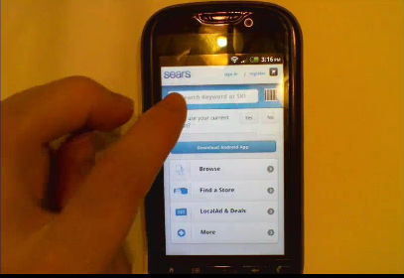
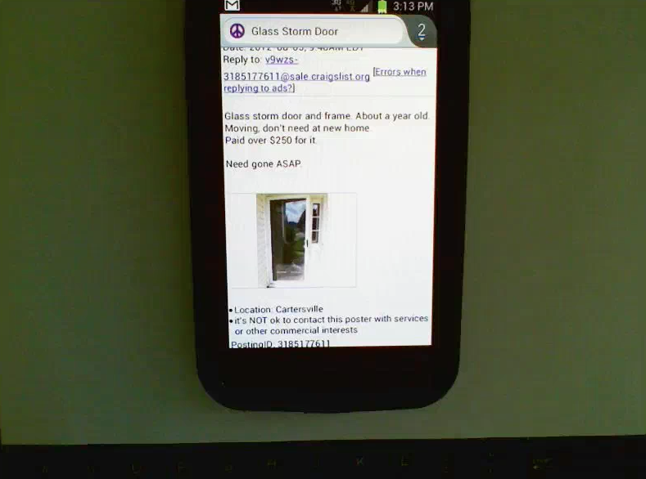
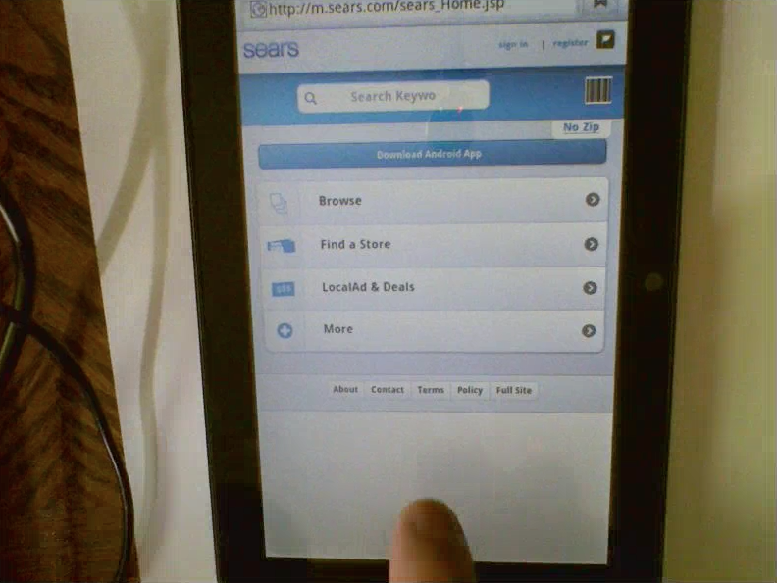
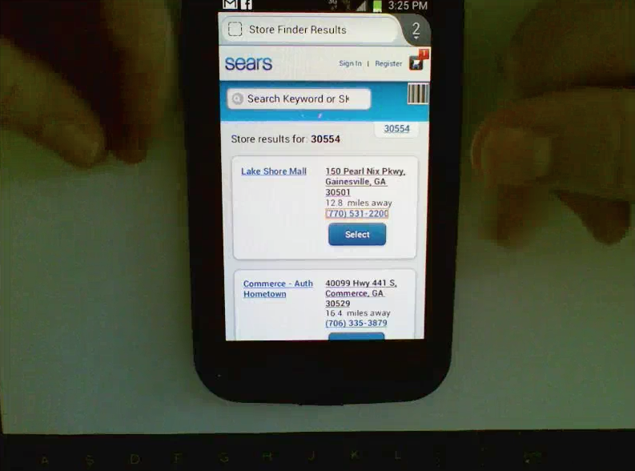
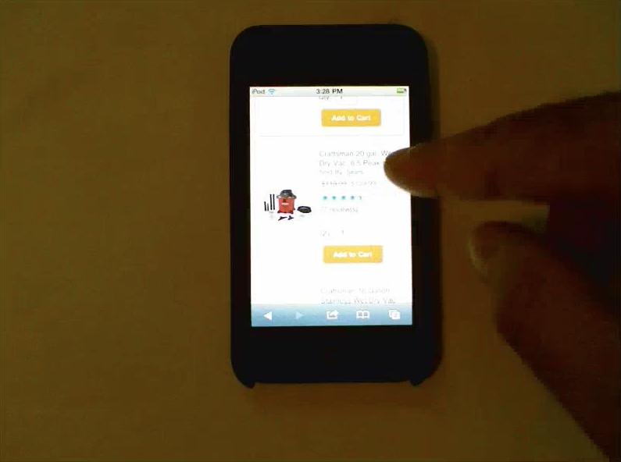
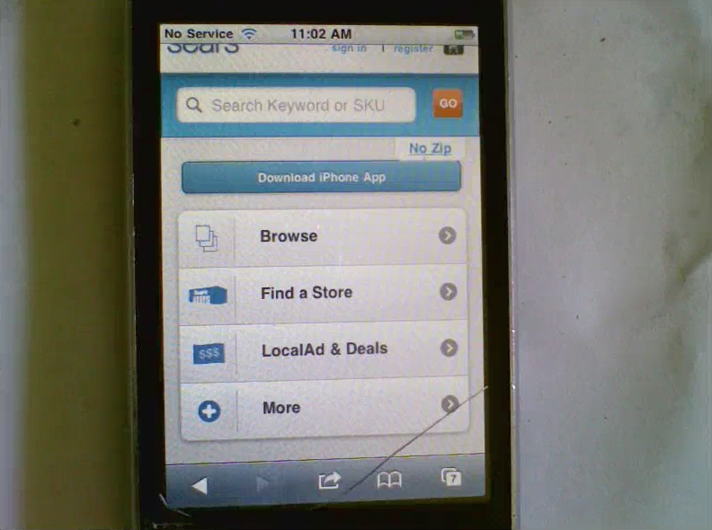
ABOUT THE TEST: Methods & Procedure
Remote test conducted over a period of 2 days with 8users (4iphone and 4 Android).
Users were screened to only include those who had made a retail purchase using their mobile phone in the last 30 days.
Users were asked to find an item of interest on the sears.com mobile site, and provide feedback regarding their experience.
Reactions to Sears.com mobile site were recorded via webcam and microphone using UserTesting.com.
Data from recordings was compiled and analyzed in order to adress key research goals and identinfy potential areas of interest regarding the sears.com mobile experience.
2

Slide 3
ABOUT THE TEST: Research Goals
To understand current customer mobile retail engagement habits
2. To monitor browsing and search behavior, both overall and on the Sears.com mobile site.
To gauge users’ overall reaction to the sears.com mobile retail experience
To understand how seras.com mobile experience compares with that of other mobile retail competitors.
To gather insights into user’s impressions of Sears as a retail brand, and to understand the degree to which this had an impact on the way users chose to engage with the sears.com mobile site.
To utilize the analysis of customer behavior to understand how and where the sight experience could be improved to help better meet customer needs going forward.
3

Slide 4
EXECUTIVE SUMMARY: Mobile Site Home Page
For almost all users, “convenience” was considered the most important factor taken info account when deciding how to go about making an online retail purchase at any given time.
Users tended to agree that mobile purchasing was generally “easier”, “quicker”, “less of a hassle” and “more enjoyable” than alternative media channels, regardless of their proximity to richer media channels (home computer, laptop, etc.)
Personalization, customization, and pre-authentication, and application use were considered major advantages specific to the mobile experience that made online shopping much easier to do.
Impressions of the sears.com site were generally positive in nature, though users expressed that the site was “typical”, “good but not great” and overall neither failed to meet nor exceeded their expectations of a mobile retail site.
Users felt earch results often “too large”, “overwhelming”
Users encountered difficulty utilizing the Sort feature on search results.
Several users expressed a desire for the sort to be product specific (as opposed to static across product types)
A few users encountered buggy/unwanted/unexpected search yields when attempting to filter results using Sort.
The most popular destinations for online shopping among the 8 users were Amazon.com and Ebay.
Types of items purchased varied greatly, and was dependent upon user-specific circumstantial factors .
When asked to reflect on the Sears.com mobile site experience, users felt that it was easy, efficient, and intuitive overall, and that it was “in line with their expectations”.
No strong negative reactions to the site were reported, though a few users expressed mild dissatisfaction with the search process overall, filtering and sorting, and aethetic presentation.
7 out of the 8 users said that they be likely both to use the site again themselves to make a purchase, and to recommend the site to someone else to use (friend, co worker, family, etc.)
4

Slide 5





Issue Severity Legend
Positive – Successful finding
High – Issue is must be addressed to avoid significant negative impact to user experience.
Medium – Issue is should be addressed to avoid moderate negative impact to user experience.
Low – Issue is beneficial to address to avoid limited negative impact to user experience.
FYI – Informational note
Bug – system error
5

Slide 6

TOPIC: Customer trends: Mobile Shopping Destinations
Severity:
Observations:
Amazon and Ebay were the most popular destinations for mobile shopping, as reported by users. However, the list of online mobile retailers was fairly robust (as indicated in the tag cloud to the right).
Users expressed that they chose to shop at Amazon and Ebay most often because they were more likely to find “anything” they might be looking for in one stop, often despite user frustrations with site function and usability.
Preconceptions about a particular retailer’s breadth of retail inventory available for purchase has a threefold affect on consumer behavior – namely, frequency, purchasing behavior, and engagement. Retailers with perceived “large” offerings were visited more frequently, used for both deliberate purchasing and browsing, and received repeated engagement from users. Conversely, “specialty” retailers were perceived as having “smaller” offerings that were only conducive to one-time deliberate purchases, were less conducive to browsing, and were less likely to experience repeat consumer engagement.
Implications:
As a retailer with a very large breadth of offerings, Sears.com should consider potential methods for increasing consumer awareness of the site and the benefits if offers to users. It might be useful to consider how Sears.com might advertise itself as a site that not only offers a comparable retail inventory to that of an Amazon or Ebay, but also offers a significantly superior user experience overall. (intuitive search and browse, efficient/intuitive functionality, additional “bonuses” through competitive pricing, SYW, etc.).
6

Slide 7
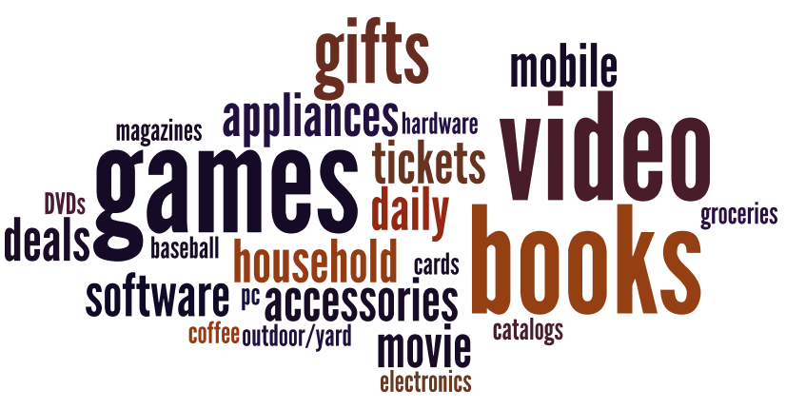
TOPIC: Customer Shopping Trends: What Do They Buy?
Severity:
Observations:
User use their mobile phones to purchase a wide variety of products, ranging from groceries and food to movie tickets to baseball cards.
“Video Games” and “Books” were the two most frequently reported purchases.
The items users chose to shop for when on Sears.com mobile were noticeably different from the previously reported purchases, and tended to skew toward home/bedroom suplies, outdoor/lawn and garden supplies, and appliances.
(Items of interest included : Call of Duty (Xbox game) , Pressure washers, Blenders, Bed Spreads, Replacement vaccuum bags, Shop Vacs, Screen Doors, Infant Car seats, Hammocks, Screen Doors).
Implications:
The difference in users’ shopping behavior on Sears.com is a good example of how users’ perceptions of a particular retailer or brand can influence a) what kinds of things they feel are available for purchase and consequently b) what they would use the site to purchase. Shopping behavior on the Sears.com site suggests an inherent association with the Sears brand as a provider of a specific set of retail items, namely, those related to appliances/hardware/home décor/home repair etc.
Consider surfacing the importance (and existance) of some of the less-recognized retail categories within the Sears inventory by inviting users to engage with them (via visual cues, copy, navigation) wherever possible.
7

Slide 8
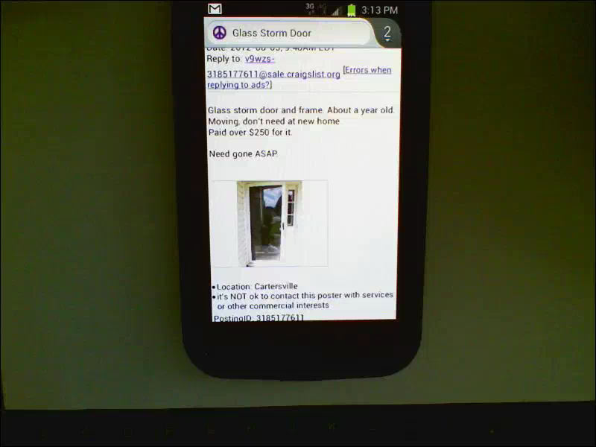
TOPIC: Customer Shopping Trends: Where Do They Buy?
Severity:
Observations:
“Whenever the moment Strikes.”
Users said that were mostly likely to make purchases on the mobile phone “when they had the time”, regarless of whether they were at home or away.
While at home, users expressed that using one’s smart phone even when close to a laptop or desktop computer was just “easier”, as their phones were usually closer to them, readily available, and users felt that they could accomplish the same tasks without the hassle of “opening a laptop” or “booting up a computer in the next room”
Implications:
As we grow ever more comfortable with our smart phones, our likelihood to want to use them to do things like shop is increasing. All users demonstrated strong proficiency using their mobile phones to engage in retail behavior.
Consider ways to create awareness around sears.com mobile and the many retail utilities it provides to users.
People are already using their phones, and they are using them more and more frequently to make retail purchases. With increased awareness of and extra encouragement to engage with the sears.com mobile site, users will be more likely to remember the site in the future .
<USER CAM>
In this example, one user mentioned how in bed one night inspired her to want to purchase two old paperback books she used to have. With her phone just inches away, she was able to make this “spur of the moment” purchase.
8

Slide 9
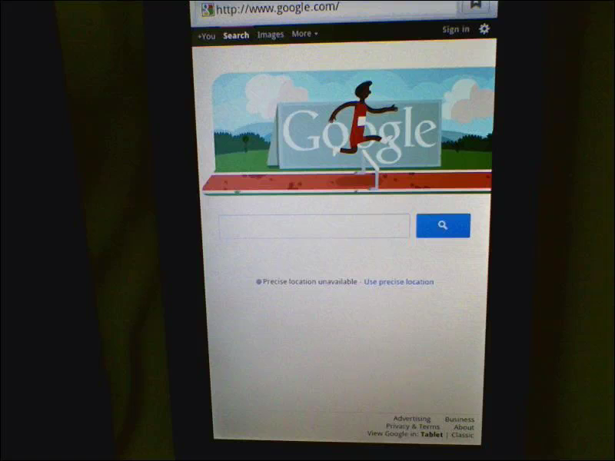
TOPIC: Customer Shopping Trends: Why Users “Go Mobile” to Shop
Severity:
Observations:
Similar to the “Where”, users cited “convenience” as the #1 determinant of why they chose to use their mobile phone to make a purchase. However, “evaluating convenience” isn’t as easy at it sounds. Every user takes into account any number of infinite factors in order to decide whether or not a particular action (such as using a phone to make a purchase) is “convenient” at any particular time. Users specifically mentioned things like:
Proximity to alternative technology vs. mobile phone
Time required to engage with said technology v. mobile phone
One’s physical location / availability or alternative technology
What, and how “complex” the specific item of purchase or goal is
Immediacy/Impulse level associated with purchase
Familiarity with mobile site in question
Availability of pre-authenticated/personal preference settings
Ability to check prices, make bids, research products on the go.
<USER CAM>
Implications:
Since it’s impossible to predict what might one choice more convenient than another for every possible use case scenario, consider focusing on the big picture. Consider focusing on some other convenience “standards”, such as further streamlining purchasing proces, personalization, preferences, authentication, providing accomodations for “quick purchasers” as well as for “browsers”, etc. to help invite users to engage, shop, and browse at their own pace.
Convenience is King when it comes to making mobile retail purchases.
9

Slide 10
TOPIC: The What/When/Where/Why : Tying it all together
It all comes down to – well, everything! The what/when/where and why of mobile retail are deeply intertwined in determining the users’ ultimate course of action. No instance of a user using one evaluative measure over the others was encountered throughout any of the 8 sessions. Rather, all of these determinants were taken into consideration cumulatively by users when deciding a course of action. Consider the following scenario:
Jose is on a 45 minute lunch break, which he takes in the office lunch room. While reheating some soup, he takes note of the state of disrepair of the kitchen microwave and decides to be charitable and purchase another one. Since Jose is a member of Amazon Prime, he knows he can get a good price. With 15 minutes to spare after eating, he goes to Amazon to browse for microwaves, and chooses the cheapest one from the list for purchase.
In this seemingly simple order of events, Jose had made a serious of very complex decisions which resulted in the purchase of a microwave from Amazon. Starting with the “When”, his choice to take his break in the office kitchen led immediately to the “What” – the decision to purchase a new microwave. From there, he chose to go to Amazon (where) BECAUSE (why) he is a prime member and he knew he could get a good price. Since he had 15 minutes left on his break, he had ample time to make the purchase (when again), and to reflect on his act of good samaritainship (another why).
Every user’s decision to make an online purchase is unique. Individual bevaior is driven by emotions, perceptions, memories, and experiences that cannot be measured by any precriptive parameters.
10

Slide 11
TOPIC: The What/When/Where/Why : Tying it all together
If we can’t design for every possible user case scenario, what we can do is use insights from existing user research to help make a “predictions” as to how to best meet the needs of the intended customer base, and try to come as close as possible. Should we miss the mark, we learn from our mistakes and continue to evolve the experience through iterative user testing and design implementation.
outook for Sears.com mobile is good. Users have a positive impression of the site overall and are open to it’s offerings. With appropriate attention paid to user needs, feedback, concerns, etc., the site has the potential to evolve into a top performer. If overlooked, however, the site will likely suffer significantly moving forward.
Looking forward, as the number of available mobile retail experiences grow, users’ authority to choose will gain significant importance. Only the best of the best mobile experiences will rise to the top as competition becomes more fierce and users become more discerning
As the mobile phone becomes an increasingly ubiquotous and powerful tool, the technology provided for the user must follow suit. The mobile experiences that will thrive will be those that best meet our needs and expectations as human beings. This means paying attention to things like user emotions, expectations, frustrations, and perceptions and adapting to them on a constant basis. Without this focus, no experience can succeed. As makers of mobile technology, the question is simple: Sink or Swim?
11

Slide 12
Topic: Initial Reactions and Sentiments to Sears.com
Severity:
**caveat!
Issue: Initial reactions to the sears.com mobile home page were overall very positive.
Observations:
Most common words used to describe the sears.com are listed in the chart below. As you’ll note, users found the site to be well designed, logically categorized, easy to use, simple, quick, and generally in line with their expectations of how a retail site should behave overall.
Implications:
Though users’ reactions to the site were generally positive, there was a common sentiment shared among users that the site was neither any worse or any better than they expected it to be. In this case, users spoke outwardly about the positive aspects of the site, but most often chose not to discuss their perception of the site as “average” in any detail.
Consider spending some time using the site and identifying one or two features or stand-out experiences that perform “less than awesome”. Identify what realistic improvements could be made to change the experience from “ok” to “awesome”.
12

Slide 13
Topic: Reactions to sears.com Experience: Most Common “Likes”
Severity:
Observations: Overall, Users felt the site was easy, quick, efficient, had good search and browse functionality, and was categorized in a way that was intuitive and useful for them.
Implications: See Implications on Positive Feedback, p. 12.
13

Slide 14
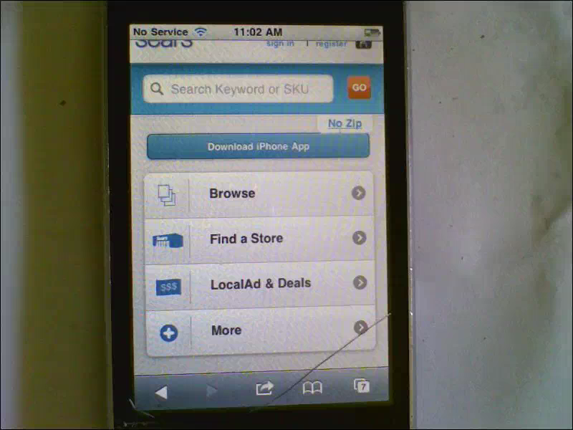
Report of Findings: MyGofer Delivery Bar – July 2012
Topic: Interaction with Sears.com: Impressions of Search Results
Severity:
Issue: A few users struggled with the amount of search returns being too high or too difficult to manage at one. One of these users was so overwhelmed she was not able to complete the main task of finding a desirable product.
Observations:
Search did often return overly abundant yields that proved hard to manage.
Users who faced this problem either:
entered in additional search criteria to “narrow down results”
Attempted to filter results using Sort
Tried to look at all the results using the existing pagination
via clicking the “more tab”
Implications: Search should be as flawless and intuitive as
Possible, as most users did use this within 20 minutes of interacting
With the site, and encountered some kind of problem.
As a portal to an axtraordinarily diverse offering of merchandise
And services, both the Search and Browse functions are of vital
Importance to the site’s, and the company’s, success.
Some areas to address are handling “abundance”, pagination/presentation, reaction to user errors like misspellings and/or problematic wording, etc., and recurring instances of “irellevant”/unhelpful search yields.
14

Slide 15
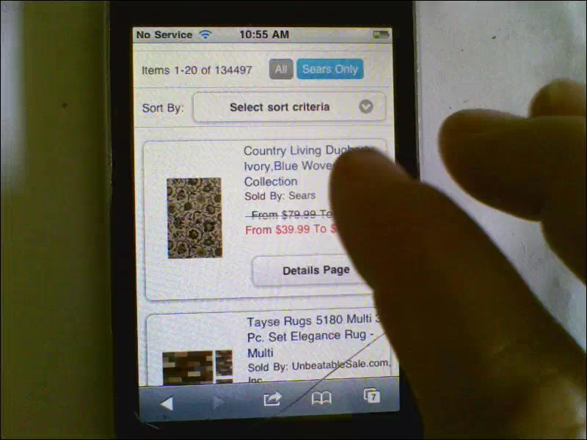
Report of Findings: MyGofer Delivery Bar – July 2012
Topic: Interaction with Sears.com: Filtering Results
Severity:
Issue: Filtering was not always intuitive to users, and did not behave in the manner they expected it to.
Observations:
The main observation to take away here is that users expected filters to be specific to the product at which they were looking. (For example, the woman below wants to be able to sort by “size of rug” – another man wanted to sort by “length of lawn mower blade,” etc.)
After coming to terms with the functions the Sort did provide, they were neither overly enthused by what was available, nor did they find them useful upon attempting to execute a filter.
Often, sorts returned odd/unexpected search sets
which forced users to have to navigate backward in their browser and start over
Overall, price low to high was the most popular sort.
Few users engaged with the rest of the filter list, or seemed to find them useful.
Implications: Because sears is a portal to such a hugely diverse world of products, it is understandable that users might expect a more sophisticated filtering system.
Namely, the ability to tailor sort by product keyword was the expectation that was not being met. As many if not most competitive mobile sites offer this feature, Sears.com may risk falling behind due to a perceived lack of “sophistication”.
<USER CAM>
15

Slide 16
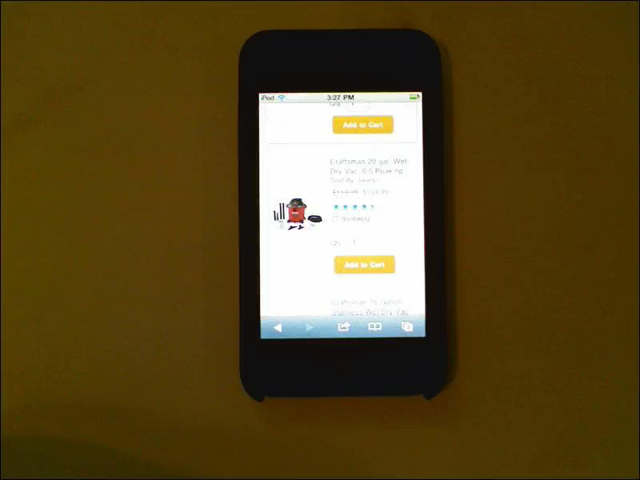
Report of Findings: MyGofer Delivery Bar – July 2012
Topic: Interaction with Sears.com: Ability to locate desired item
Severity:
Issue: All but one of eight users were able to successfully locate an item they wanted to purchase using the sears.com mobile site.
Observations: Of the 7 users who were successful, 5 were able to find a satisfactory item for purchase in 60 seconds or less. The remaining two users took anywhere between 2 and 5 minutes.
Users said that finding their desired item was easy to do and that the process was simple, quick, ifficient, and intuitive.
Implications:
<USER CAM>
16

Slide 17
Report of Findings: MyGofer Delivery Bar – July 2012
Topic: Interaction with Sears.com: Time Spent
Severity:
Issue:
Observations:
Overall, most users (6/8) were able to locate a product they wanted to purchase easily and in under 60 seconds using the mobile site.
Searching vs. browsing
Initiallly, users tended to Prefer to Browse categories when asked to find a product (6 out of 8)
However, several users did eventually utilize the search function at a later point in their
journey (5 out of 8).
Users expressed that it was “faster” to use the search bar to entire desired criteria ; however, performing a search did not always prove faster in the longrun, as several users struggled with misentered criteria, having to add additional qualifying terms, spelling errors, unwanted search yields, etc.
Generally, users tended to locate desired products faster using the browse, despite their preconceived notions of search.
Most users specifically mentioned that the categorization of items while browsing made sense, and were able to demonstrate said understanding by effectively locating desired items in a very short amount of time and with few instances of erroneous navigation.
Implications:
17

Slide 18
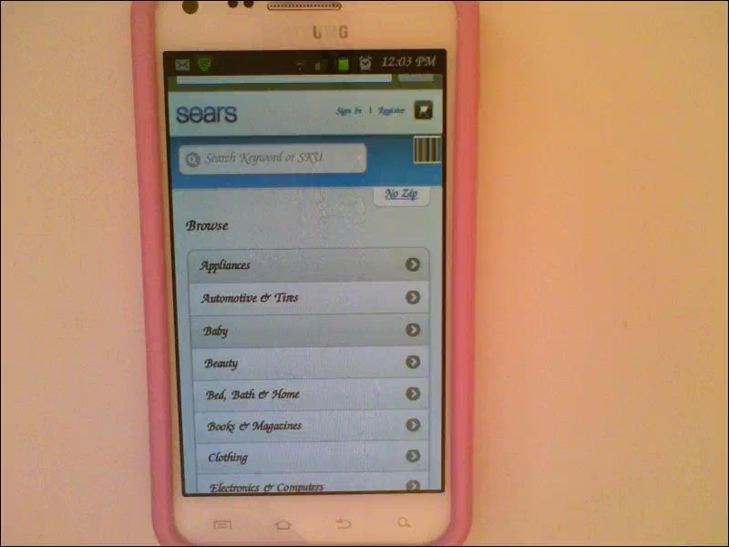
Report of Findings: MyGofer Delivery Bar – July 2012
Topic: Reactions to sears.com Experience: Positive Overall
Severity:
Issue: User’s overall Reactions to the mobile site were positive in nature.
Observations: Specifically,
Implications:
<USER CAM>
18

Slide 19
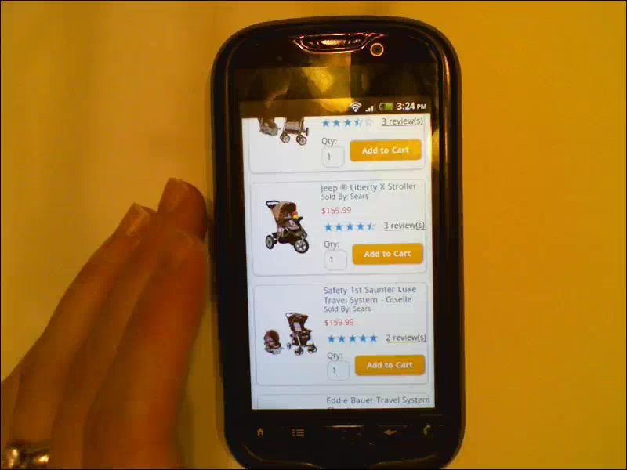
Report of Findings: MyGofer Delivery Bar – July 2012
Topic: Reactions to sears.com Experience: Most Common “Dislikes”
Severity:
Observations: “A little finicky”
Implications:
<USER CAM>
19

Slide 20
Report of Findings: MyGofer Delivery Bar – July 2012
Topic: Reactions to sears.com Experience: Overall Ease of Use
Severity:
Issue:
Observations: SCORE, overal easy
Implications:
20

Slide 21
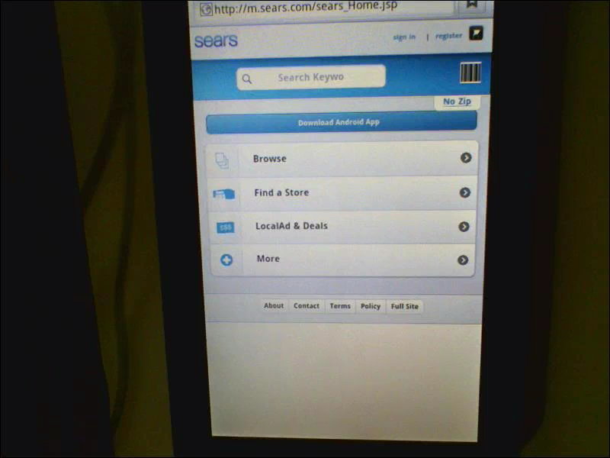
Report of Findings: MyGofer Delivery Bar – July 2012
Topic: Perception of offerings at sears, hypothetical intended use.
Severity:
Issue:
Observations:
Implications:
<USER CAM>
21

Slide 22
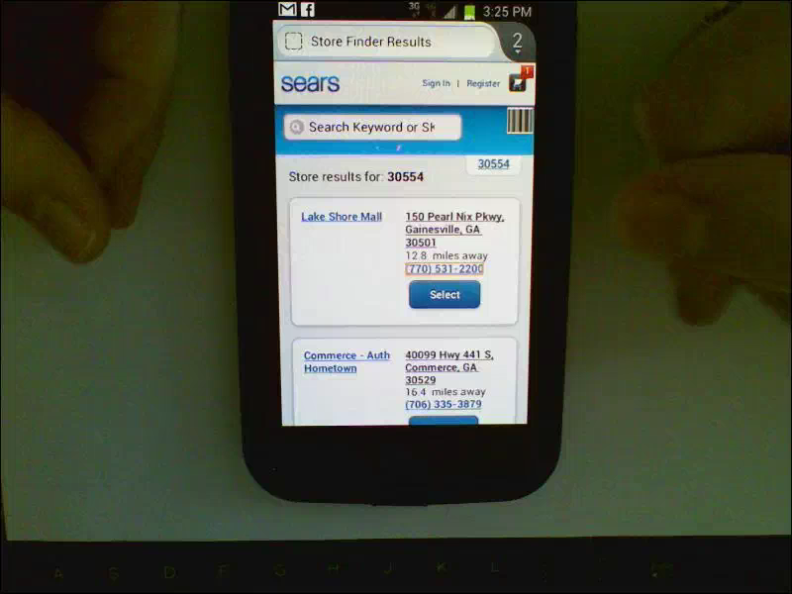
Report of Findings: MyGofer Delivery Bar – July 2012
Topic: Emotiional reactions to sears.com: Belief/trust in integrity of the brand strong, but window is closing.
Severity:
Observations:
Implications:
<USER CAM>
22

Slide 23
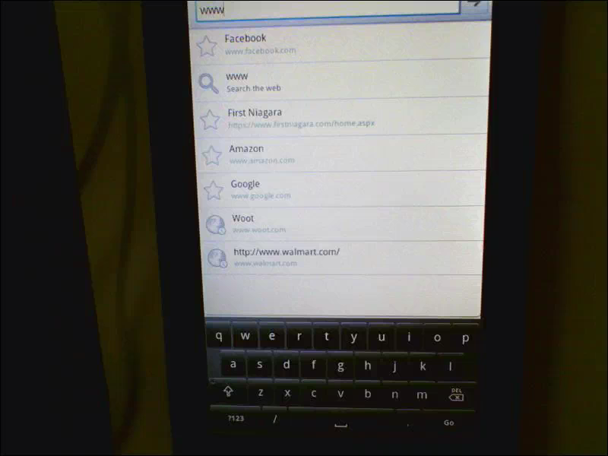
Report of Findings: MyGofer Delivery Bar – July 2012
Topic: Emotiional reactions to sears.com: Reactions to Aesthetic Presentation
Severity:
Issue: Users understand the function of the fulfillment selector in the ZIP drawer.
Observations:
Layout
Categorization
Behavior
Expectations met
Implications:
<USER CAM>
23

Slide 24
Report of Findings: MyGofer Delivery Bar – July 2012
Topic: Evaluative Response: Users likelihood to recommend the site to others
Severity:
Issue:
Observations:
Layout
Categorization
Behavior
Expectations met
Implications:
Because users did not notice the drawer after entering the ZIP (on Search flow) and were not overtly asked what they preferred for their order’s default fulfillment, users did not suspect that a header control was performing that function.
Consider engaging user with a step where they are asked how they would like to receive the current order or at least bring their attention to the default setting.
24

Slide 25
Screenshots
25

Slide 26
Video Excerpts by Topic
26

Slide 27
Video Footage: Clips by Topic
: NOTE: These recordings may be viewed only by employees of SHC and may not be shared, published or excerpted.
LINKS TO USER TESING VIDEOS CLIPS BY TOPIC
Convenience is key when choosing how to shop; Mobile proves “most convenient” more often.
Spur of the moment purchasing
Location less important than circumstance / specific user goals in determining mobile behavior.
Users reacted positively to Sears.com mobile presentation and usability.
Design Aesthetics; clean, simple, straightforward, but some users felt was “lacking personality”
Browse and Search offerings were often “too much”, overwhelming to users
Filtering was difficult, users felt filters fell short, needed to be product specific.
Most users found their desired item within less than 60 seconds, though some encountered difficulty
Users reported difficulty with “sticky” or Finicky buttons, most notably on “Browse” on the home screen.

Slide 28
Video Footage Clips by Topic (contd.)
: NOTE: These recordings may be viewed only by employees of SHC and may not be shared, published or excerpted.
TOPIC
Compared to other mobile retailers (amazon, ebay, etc), users felt the experience on sears.com was “very similar” / “about the same”.
Users perceptions of Sears as a retailer affected their idea of it’s intended use and value.
All but one user said that they would be likely to use the mobile site again, but that it would depend on what they were looking to purchase.
Preconceived notions about Sears as a retailer occasionally stifled user’s understanding of the mobile site’s shopping experience.
Positive emotional associations with the Sears brand greatly affected several user’s overall evaluation of their experience on the mobile site (Sears was seen as “strong”, “useful” “fair”, “having “integrity”, and as a provider of a “rich retail offerings.”

Slide 29
User Profiles
29

Slide 30
Report of Findings: MyGofer Delivery Bar – July 2012
Name | Age | Web | # | What purchased and Where? | Groceries? | Name of retailer/online service | Interest level in placing grocery orders online | HH Income | Occupation
 | 24 | DAILY | 4+ | TV-AMAZON, CLOTHES-PIPELIME, SLIPCOVER-BEDBATHANDBEYOND, TABLE-IKEA | YES | PEAPOD | N/A | $20-40K | RECEPTIONIST
DAN L | 49 | DAILY | 4+ | AIRLINE TICKETS-AMERICAN AIRLINES CLOTHES-GOLFNOW.COM, ZAZZLE, TOMMY HILFIGER | NO | N/A | VERY INTERESTED | $40-70K | PRINTING SERVICE REP
MICHAEL B | 27 | DAILY | 4+ | SHOES, SHIRTS, ACCESSORIES-AMAZON | YES | PEAPOD, AMAZON, EBAY | N/A | $70-120K | IT DIRECTOR
SAMANTHA S | 1 | DAILY | 4+ | CLOTHES-VICTORIAS SECRET, FOREVER 21, KOHLS FURNITURE-KOHLS IPOD-APPLE STORE | YES | PEAPOD | N/A | $40-70K | STUDENT
MARGARET L | 64 | DAILY | 4+ | BOOKS-AMAZON, SHOES-ZAPPOS, CLOTHING-KOHLS | NO | N/A | NOT SURE, BUT I MIGHT TRY IT | $70-120K | BOOKKEEPER
LISA U | 46 | DAILY | 4+ | BOOKS-AMAZON, PURSES-VERA BRADLEY | NO | N/A | INTERESTED | $120K+ | CUSTOMER SERVICE REP
30

